Slide 1
AMAZON EKS
Amazon Elastic Kubernetes Service

Slide 2
Introduction
Amazon Elastic Kubernetes Service. It’s a fully managed service that makes it easier to run Kubernetes on AWS without having to install and operate your own Kubernetes control plane or nodes.
EKS automates tasks like patching, scaling, and securing your Kubernetes clusters, letting you focus more on deploying and managing applications.
EKS (Amazon Elastic Kubernetes Service) architecture is designed to simplify running Kubernetes clusters in AWS by handling much of the complexity for you.

Slide 3
Components
1. Control Plane
Managed by AWS: The Kubernetes control plane, which consists of the API server, etcd (key-value store), and controller manager, is fully managed by AWS. You don’t have to worry about provisioning, scaling, or managing these components yourself.
Highly Available: The control plane is automatically replicated across multiple Availability Zones (AZs) for fault tolerance and high availability.
Kubernetes API Server: The API server serves as the entry point for interacting with the Kubernetes cluster, where users send commands like kubectl apply to manage resources.

Slide 4
2. Worker Nodes (EKS Nodes)
These are the EC2 instances that run your containerized applications. You can provision them manually or use Managed Node Groups, which are automatically managed by EKS.
Node Groups: A set of EC2 instances that run the Kubernetes worker node processes (like Kubelet and Kube Proxy). These nodes can be scaled up or down based on the resource requirements.
Amazon EC2 Instances: Worker nodes are EC2 instances that run your container workloads (pods). EKS allows you to use different instance types to suit your application’s needs.

Slide 5
3. EKS Managed Node Groups
These groups manage the lifecycle of EC2 instances in your cluster. When you create a node group, EKS automatically provisions and manages the EC2 instances for you.
EKS ensures that the nodes in a node group are running the proper versions of the Kubernetes software and are properly configured for optimal performance.

Slide 6
4. Pod Networking
EKS uses Amazon VPC (Virtual Private Cloud) to manage networking for your Kubernetes pods.
Amazon VPC CNI Plugin: This allows your pods to have direct access to VPC networking, making it easy for your pods to interact with other AWS services like RDS, DynamoDB, S3, etc.
Each pod gets its own IP address, and traffic between pods can be managed by the CNI plugin.

Slide 7
5. Elastic Load Balancer (ELB)
For exposing services to the internet or internal applications, EKS integrates with ELB (Classic Load Balancer, Application Load Balancer, or Network Load Balancer). When you deploy a service with type LoadBalancer, EKS automatically provisions and configures the appropriate ELB.

Slide 8
6. IAM (Identity and Access Management) Integration
IAM for Service Accounts: EKS allows you to associate IAM roles with Kubernetes service accounts, providing fine-grained access control to AWS resources.
IAM Policies: You can define policies that specify what actions can be performed by the Kubernetes nodes, services, and users within the cluster.

Slide 9
7. Storage Integration
Amazon EBS (Elastic Block Store): For persistent storage, you can use Amazon EBS volumes attached to your EKS worker nodes.
Amazon EFS (Elastic File System): For shared storage that multiple pods can access simultaneously, EFS can be used.
Amazon S3: You can also use S3 buckets for object storage within your Kubernetes workloads.

Slide 10
8. Auto Scaling
Cluster Autoscaler: Automatically adjusts the size of your worker node pool based on resource requests from the running pods. If there are not enough resources, it will add more nodes.
Horizontal Pod Autoscaler (HPA): Automatically scales the number of pod replicas based on CPU and memory usage or custom metrics.

Slide 11
9. Logging and Monitoring
Amazon CloudWatch: EKS integrates with CloudWatch for logging and monitoring, allowing you to collect metrics, logs, and events from your clusters.
AWS X-Ray: For tracing requests through your Kubernetes workloads, you can use X-Ray for debugging and performance monitoring.
Prometheus and Grafana: Many users also deploy Prometheus for metrics collection and Grafana for visualization.

Slide 12
10. Add-ons
EKS provides various built-in Kubernetes add-ons like CoreDNS, KubeProxy, and VPC CNI Plugin to help with the functionality of your cluster.
AWS App Mesh: For managing microservices within your EKS cluster, you can use AWS App Mesh for service mesh capabilities.

Slide 13
11. Security and Access Control
IAM Authentication: EKS integrates with AWS IAM to allow you to control access to your Kubernetes cluster using IAM users and roles.
RBAC (Role-Based Access Control): Inside Kubernetes, you can use RBAC for fine-grained control over who can perform specific actions on Kubernetes resources.
Secrets Management: You can use AWS Secrets Manager or AWS Systems Manager Parameter Store to manage sensitive data securely.

Slide 14
Flow
You submit a kubectl command to interact with the Kubernetes API server, which is running in the AWS-managed control plane.
The control plane processes your request and interacts with the worker nodes in the cluster.
The worker nodes (EC2 instances) run the containers and services specified in your Kubernetes configuration.
Depending on your configuration, your applications might interact with AWS services like RDS, S3, or DynamoDB.

Slide 15
Deploying and Scaling an Amazon EKS Cluster
**Step 1: Installing the required tools**
1. Install and configure the AWS CLI
2. Install [kubectl]
curl -LO "https://dl.k8s.io/release/$(curl -L -s https://dl.k8s.io/release/stable.txt)/bin/linux/amd64/kubectl"
sudo install -o root -g root -m 0755 kubectl /usr/local/bin/kubectl
3. Install the [eksctl]) command-line tool
vi eksctl.sh
paste all these commands into this vi file
ARCH=amd64
PLATFORM=$(uname -s)_$ARCH

Slide 16
curl -sLO "https://github.com/weaveworks/eksctl/releases/latest/download/eksctl_$PLATFORM.tar.gz"
# (Optional) Verify checksum
curl -sL "https://github.com/weaveworks/eksctl/releases/latest/download/eksctl_checksums.txt" | grep $PLATFORM | sha256sum --check
tar -xzf eksctl_$PLATFORM.tar.gz -C /tmp && rm eksctl_$PLATFORM.tar.gz
sudo mv /tmp/eksctl /usr/local/bin
4.chmod +x eksctl.sh
5.sudo sh eksctl.sh

Slide 17
**Step 2: Creating an EKS Cluster**
1. Create a new Amazon EKS cluster using the `eksctl` command:
eksctl create cluster --name my-eks-cluster --region us-east-1 --nodegroup-name my-nodegroup --node-type t2.small --nodes 3 --nodes-min 1 --nodes-max 5 --managed
--Replace `my-eks-cluster` and `us-east-1` with your preferred cluster name and AWS region.
**Step 3: Deploying a Sample Swiggy Application**
Create a new file named `deployment.yaml` with the following content:
Deploy the sample application to your EKS cluster:
kubectl apply -f deployment.yaml

Slide 18
**Step 4: Exposing the Application**
1. Expose the application using a Kubernetes service:
kubectl expose deployment nginx-deployment --type=LoadBalancer --name=my-service
2. Get the external IP address of the LoadBalancer:
kubectl get services my-service
3.You can access the sample application using the external IP address and port number which was mentioned in your deployment.yaml in my case i.e 3000
## Delete the service and cluster
kubectl delete svc my-service
eksctl delete cluster --name my-eks-cluster

Slide 19
Deployment.yaml File
apiVersion: apps/v1
kind: Deployment
metadata:
name: swiggy
labels:
app: swiggy
spec:
replicas: 2
selector:
matchLabels:
app: swiggy
template:
metadata:
labels:
app: swiggy
spec:
terminationGracePeriodSeconds: 30
containers:
- name: swiggy
image: sumalatha151/swiggy:latest
imagePullPolicy: "Always"
ports:
- containerPort: 3000

Slide 20
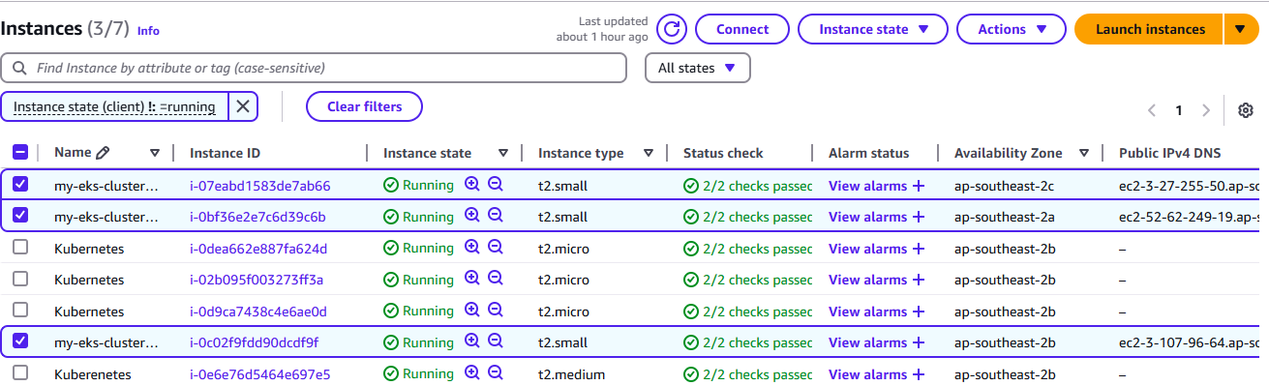
EKS Nodes

Slide 21
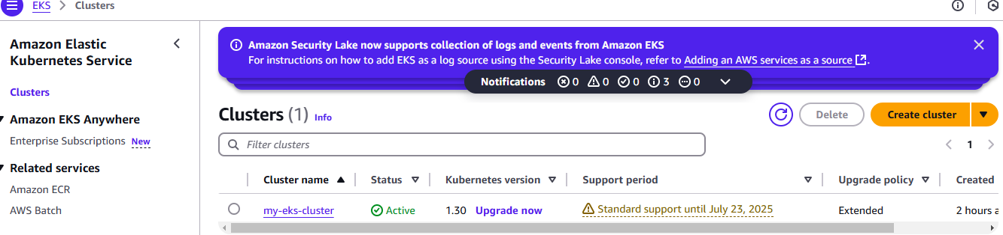
Creating an EKS Cluster

Slide 22
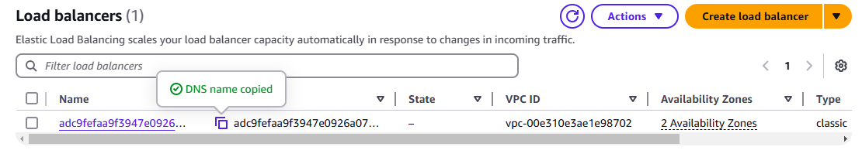
Expose the application using a Kubernetes service to LB

Slide 23
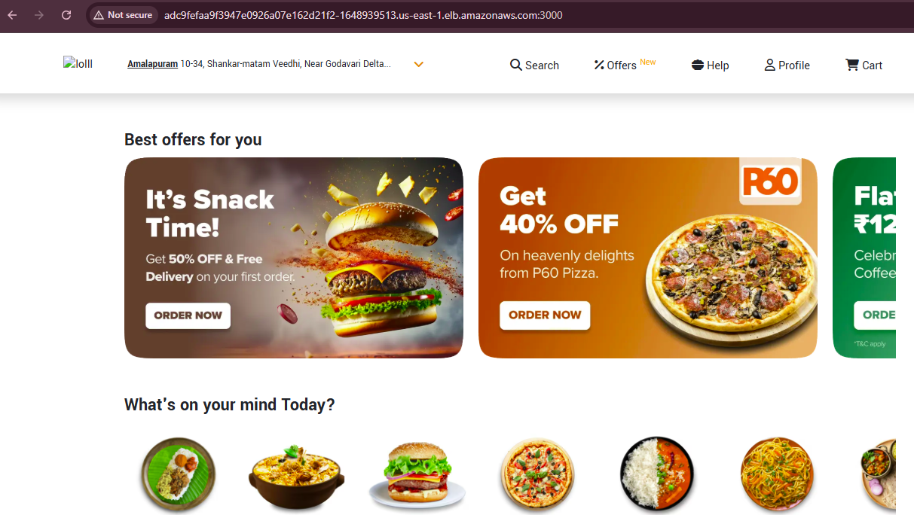
Deploy the swiggy application to EKS

